Slide 1



Kevin Miele

Slide 2
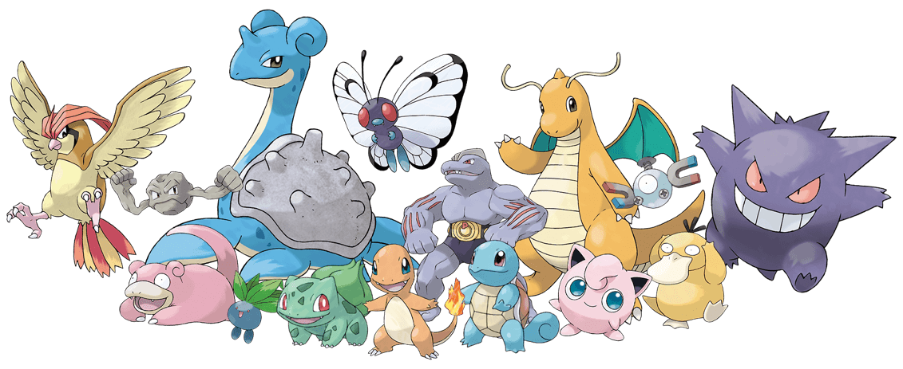
What Is Pokémon?
Japanese Franchise
Pokémon Universe
Unique powers and battles
Notes:
Add more detail but don't put too much

Slide 3

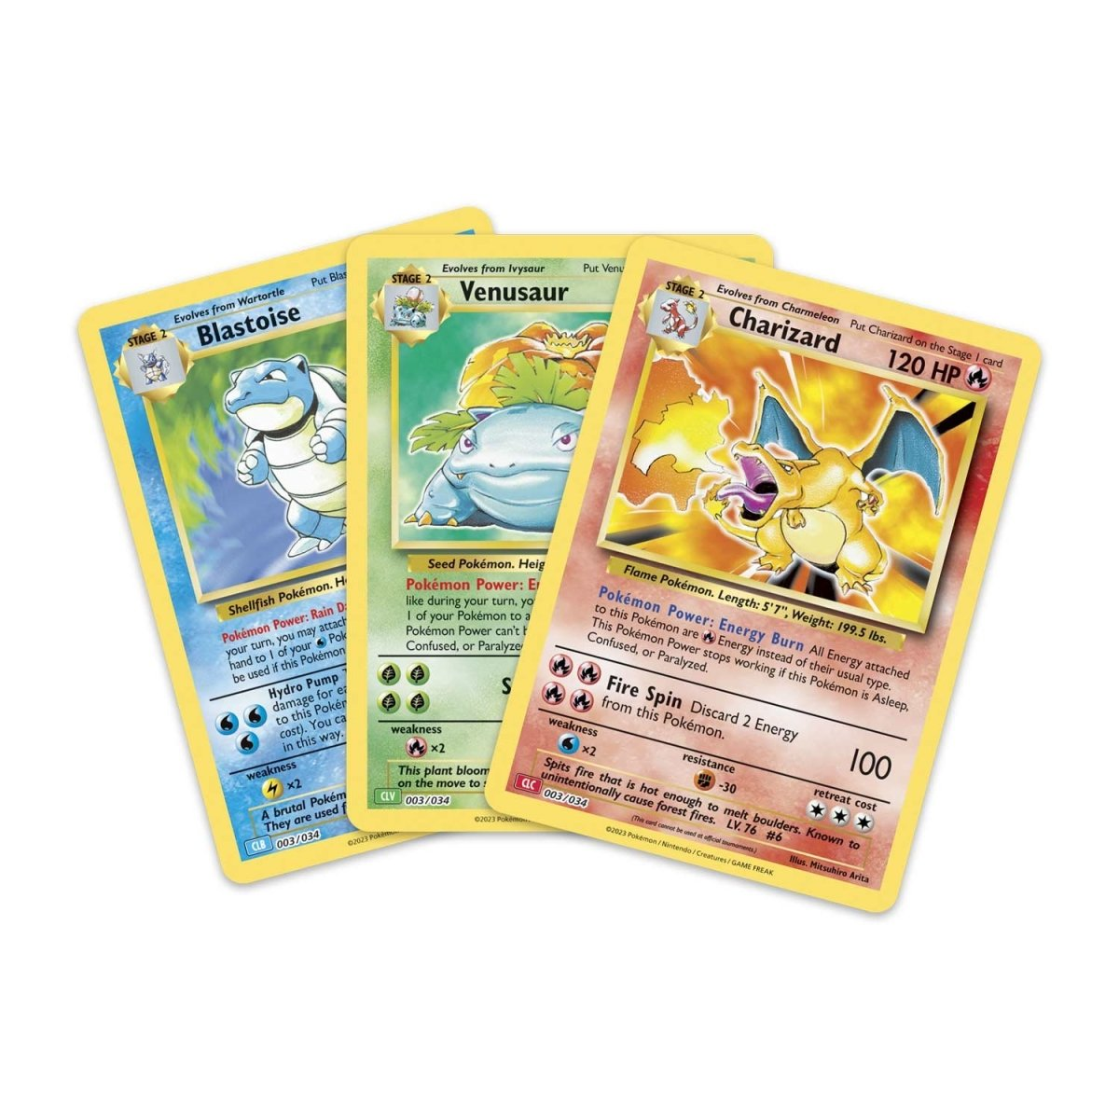
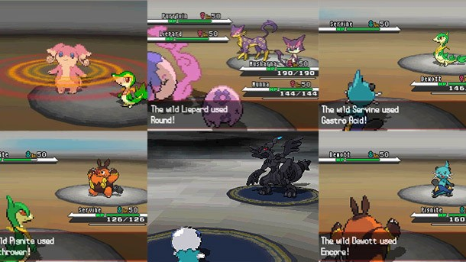
Why I Chose This Dataset?
Childhood
VHS
Trading Cards
Curiosity

Slide 4
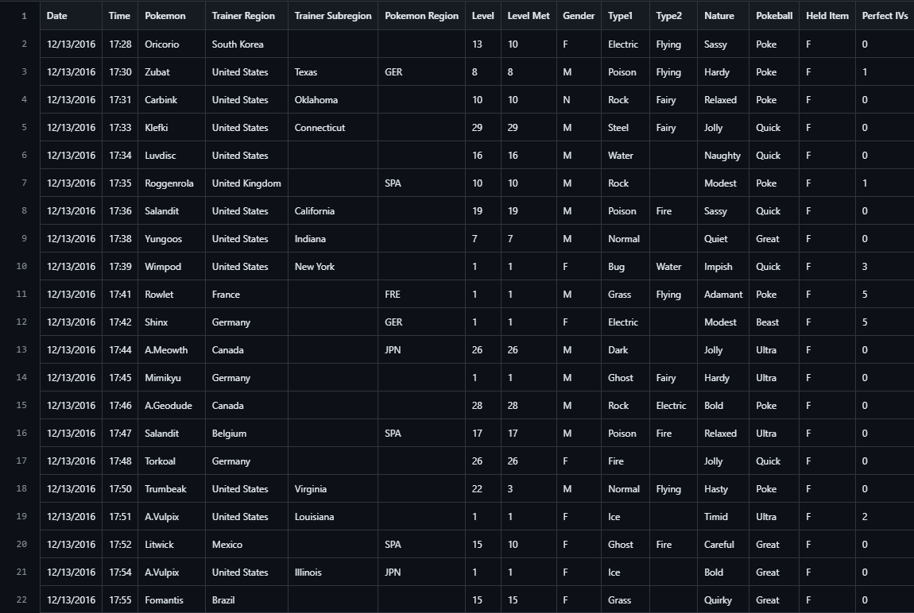

Slide 5

Where Is This Data From?

Slide 6
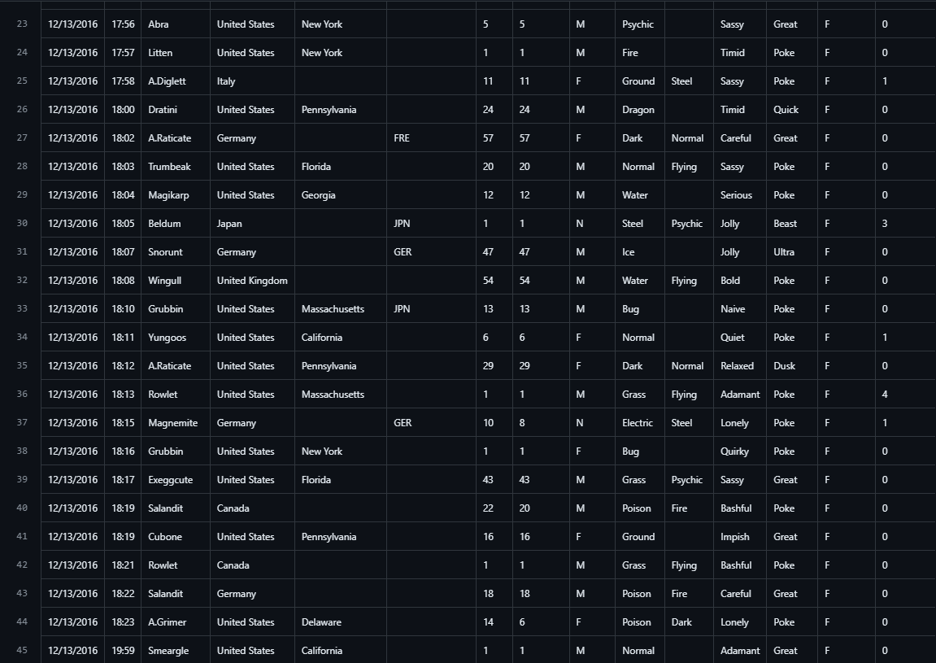

Slide 7

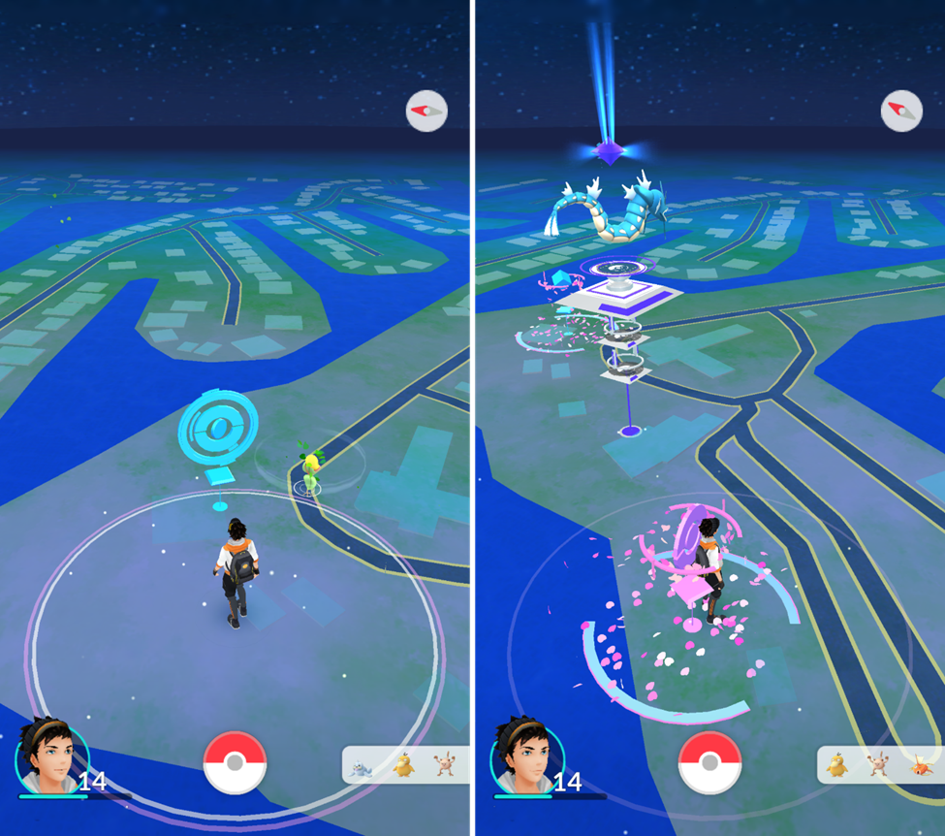
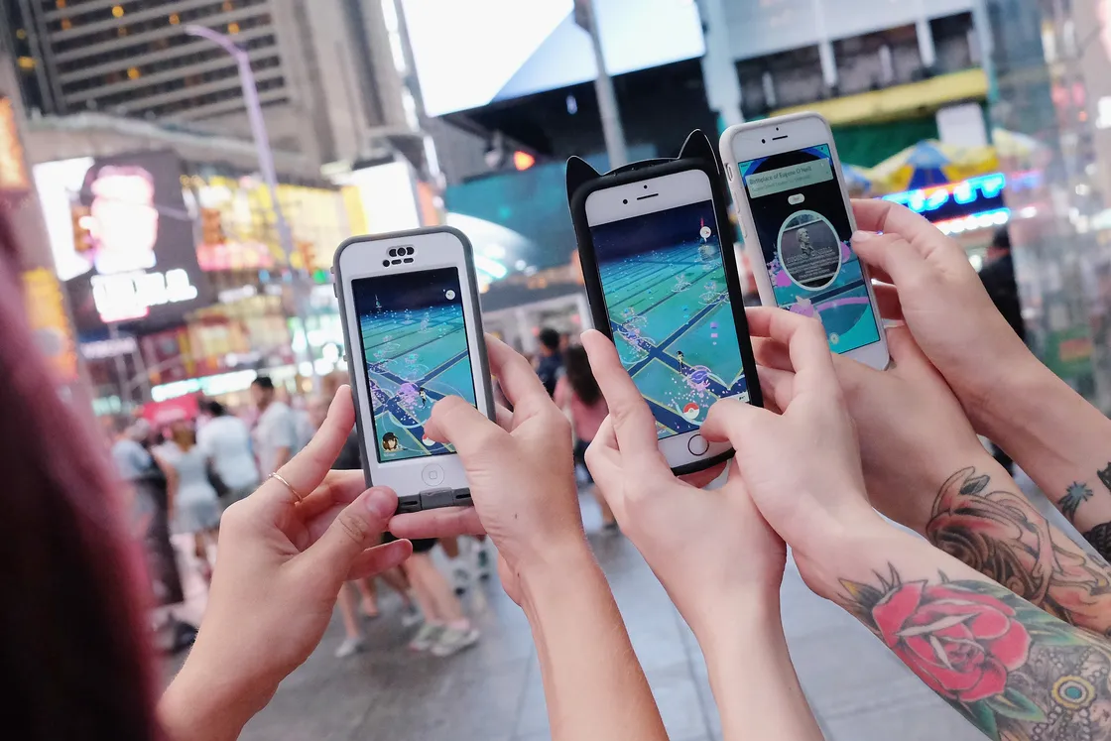
July 6th, 2016

Slide 8
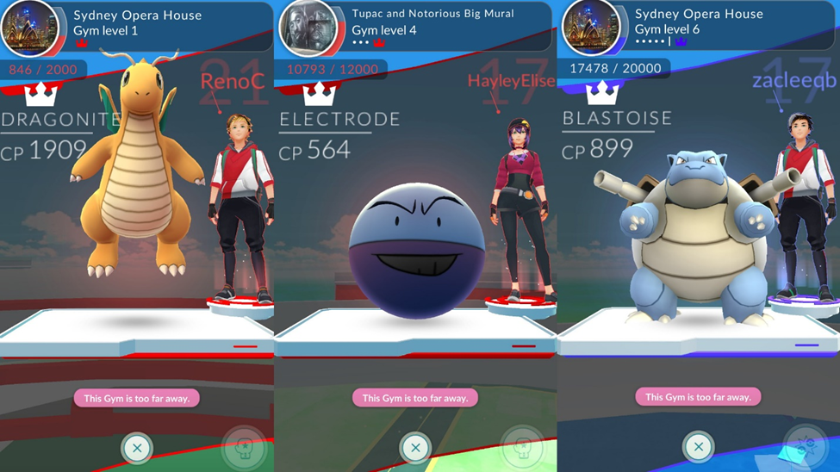
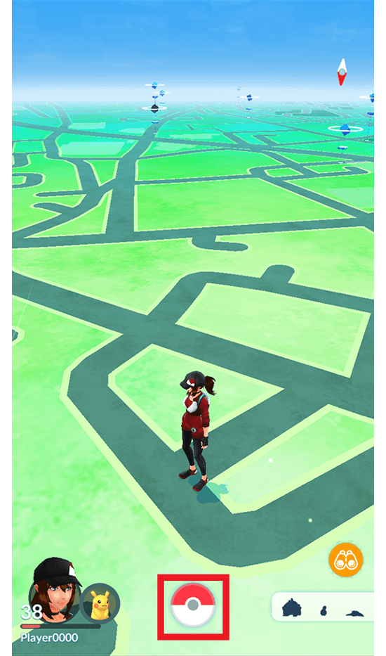
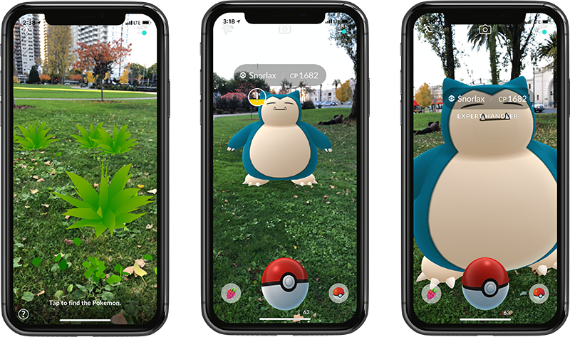
A Brief Explanation Of Pokémon GO:
Pokéstops
Gyms
Camera
GPS

Slide 9
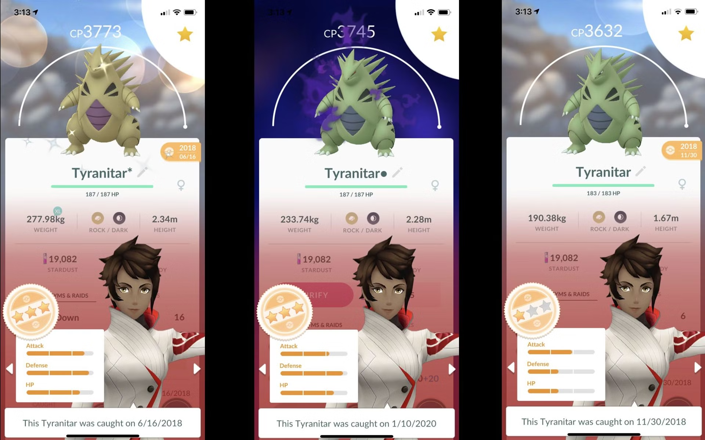
A Closer Look…

Slide 10
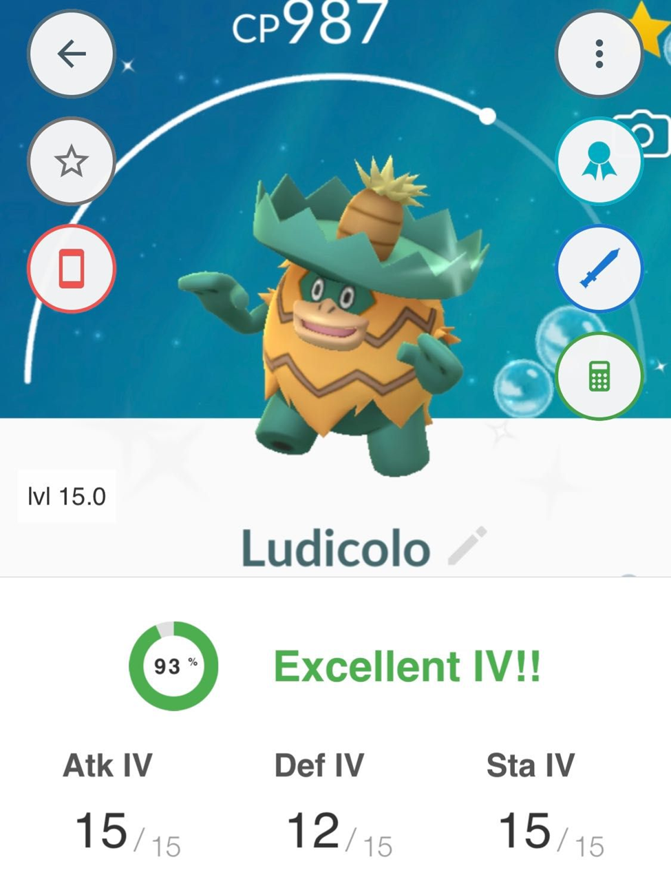
Male, Female, or Neutral (Unknown).

Slide 11
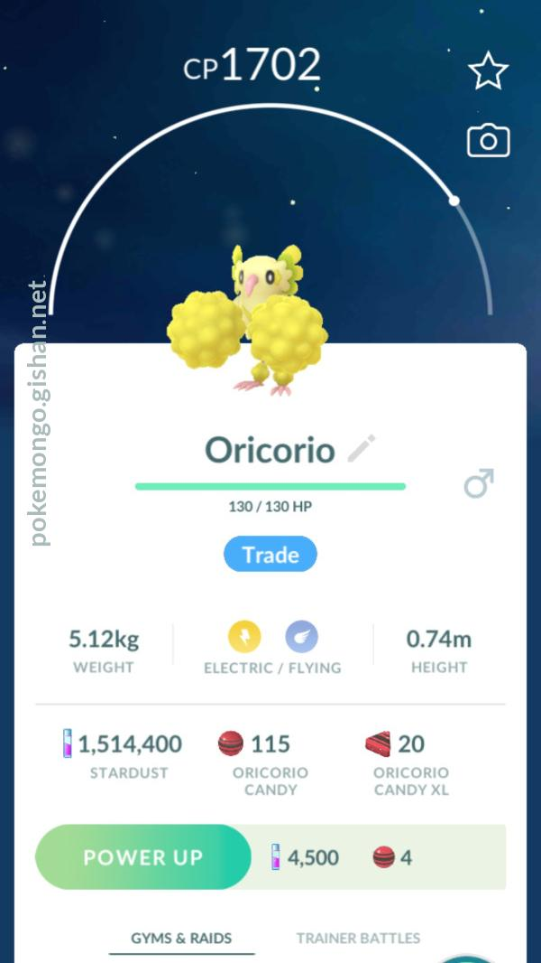
Combat Power

Slide 12

A Pokémons nature. Ex: Sassy, Lonely, Jolly.

Slide 13
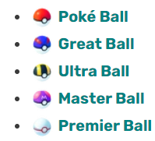

Slide 14
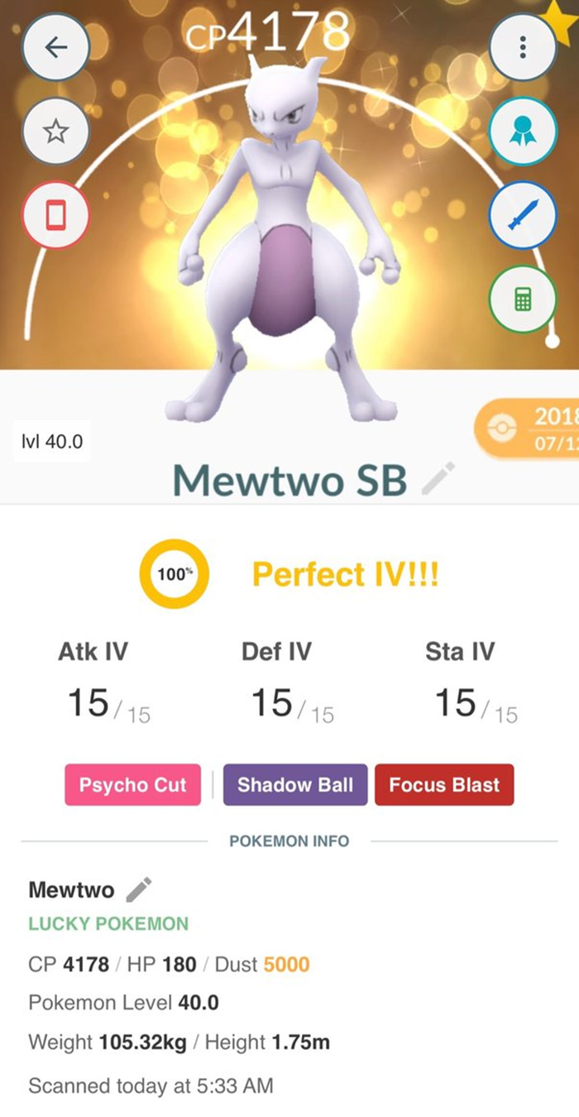
Items that help the player catch Pokémon.
Ex: Revives, Incense.

Slide 15
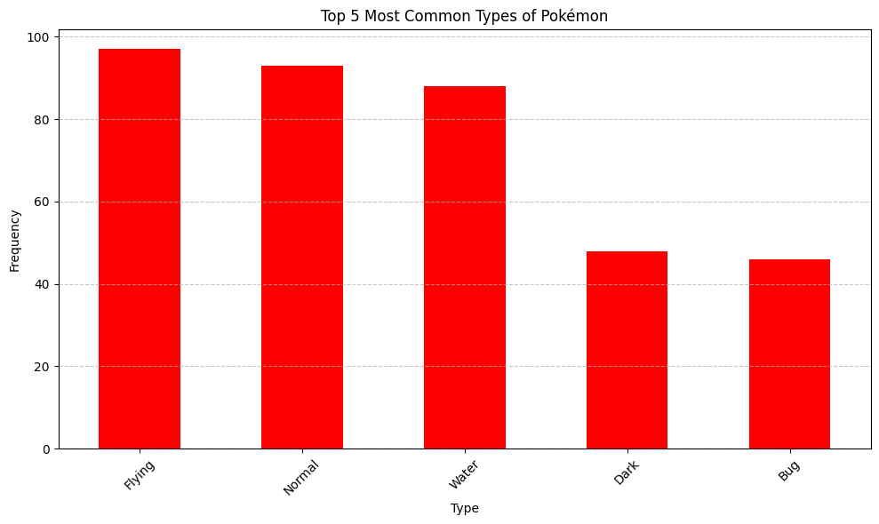

Slide 16
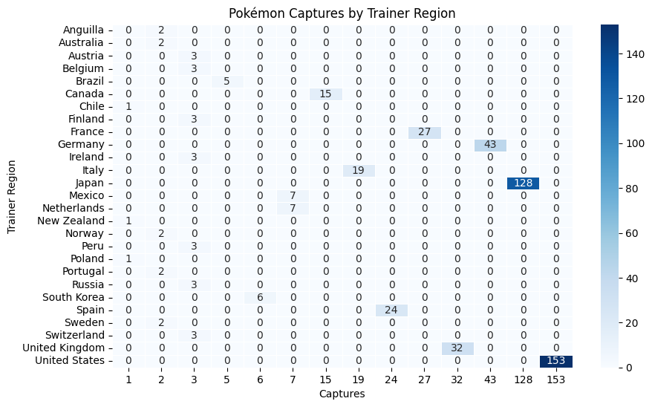

Slide 17
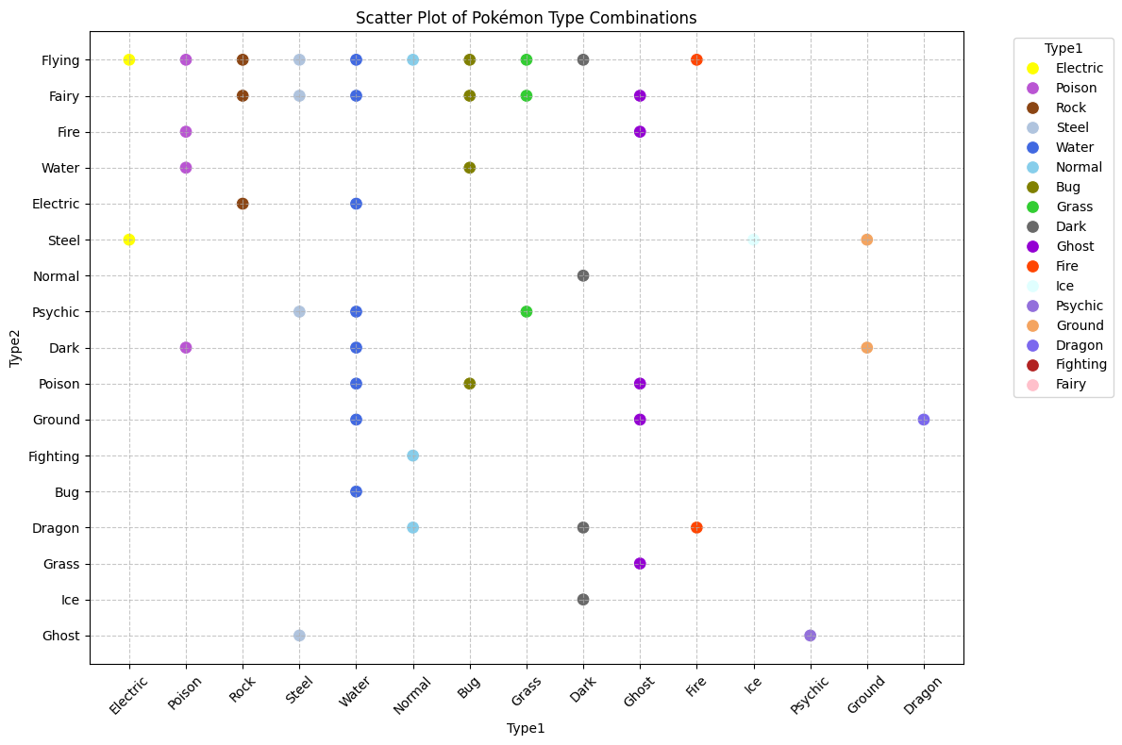

Slide 18

The Bigger Picture: What Does This All Mean? Why Do We Care?
Business Perspective
Variability
Society
Human Personality
Role-Model

Slide 19
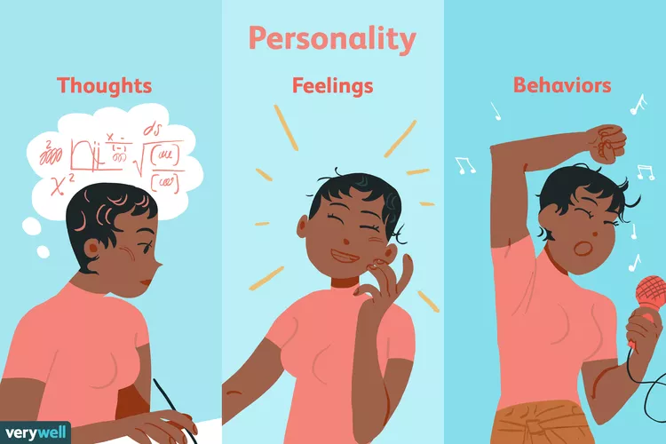
What Other Ways Could This Data Be Interpreted?
Pokémon captures and time of day
Comparison with other data sets like a list of people's personality type and the Pokémon they are more likely to capture
Which Pokémon is the most popular?
What do you think?

Slide 20

Questions? What Is Your Favorite Pokémon?

